Slide 1
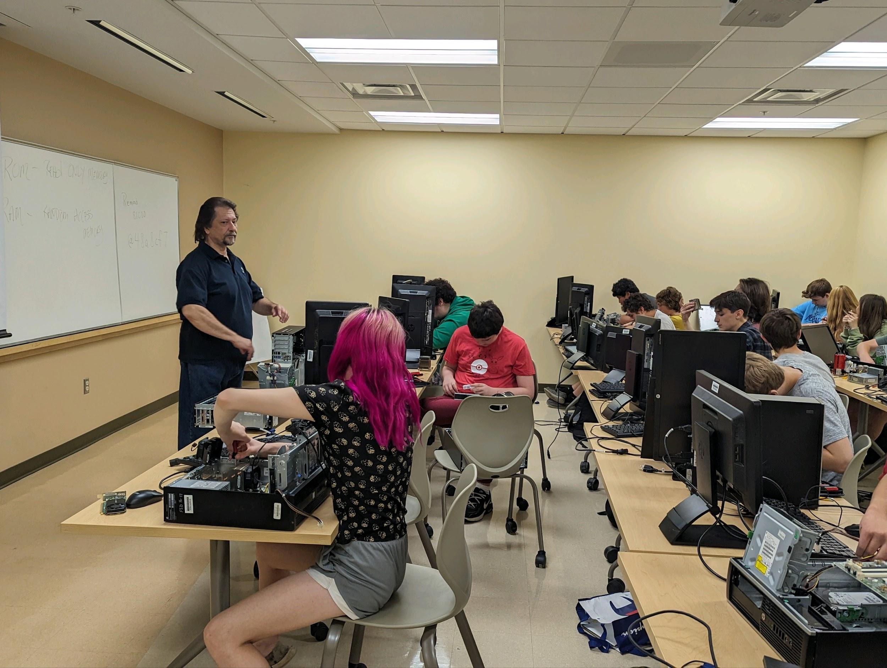
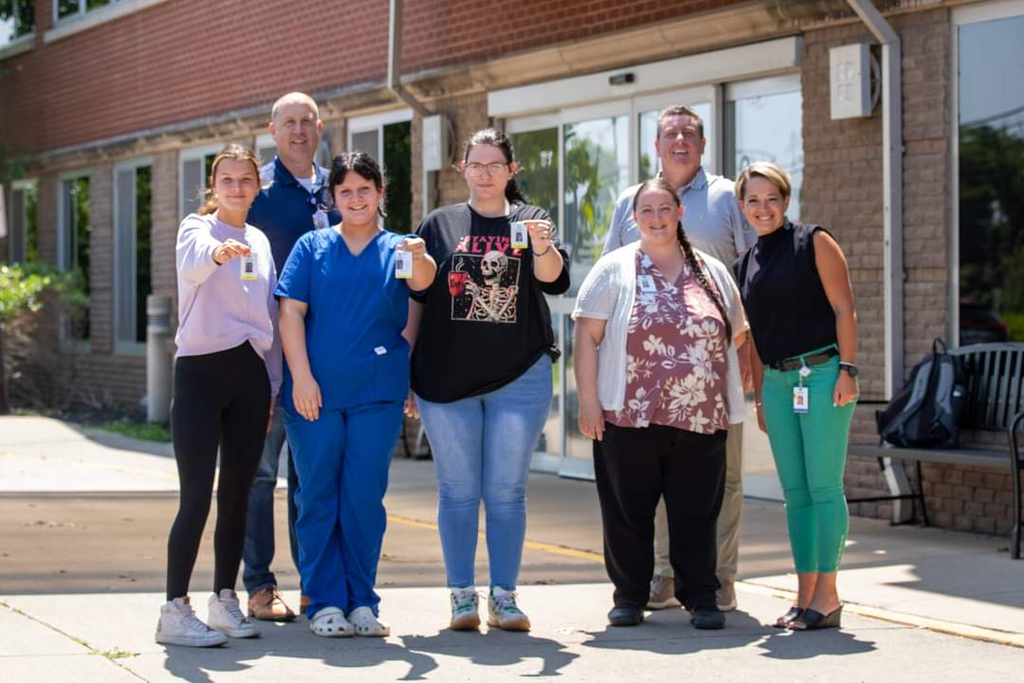
A collaboration between the Fulton, Mexico and Hannibal Districts
CCC -Microcomputer Maintenance
Oswego Health
Oswego Health

Slide 2
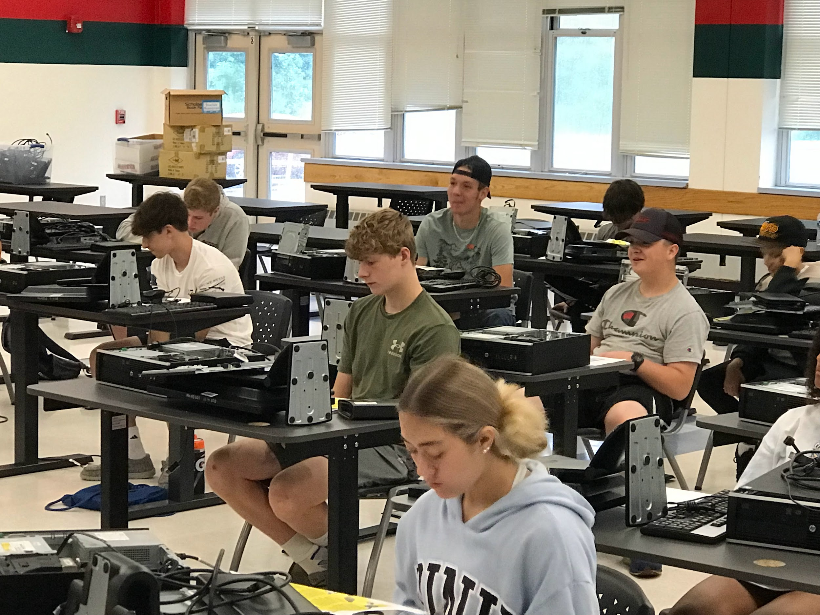
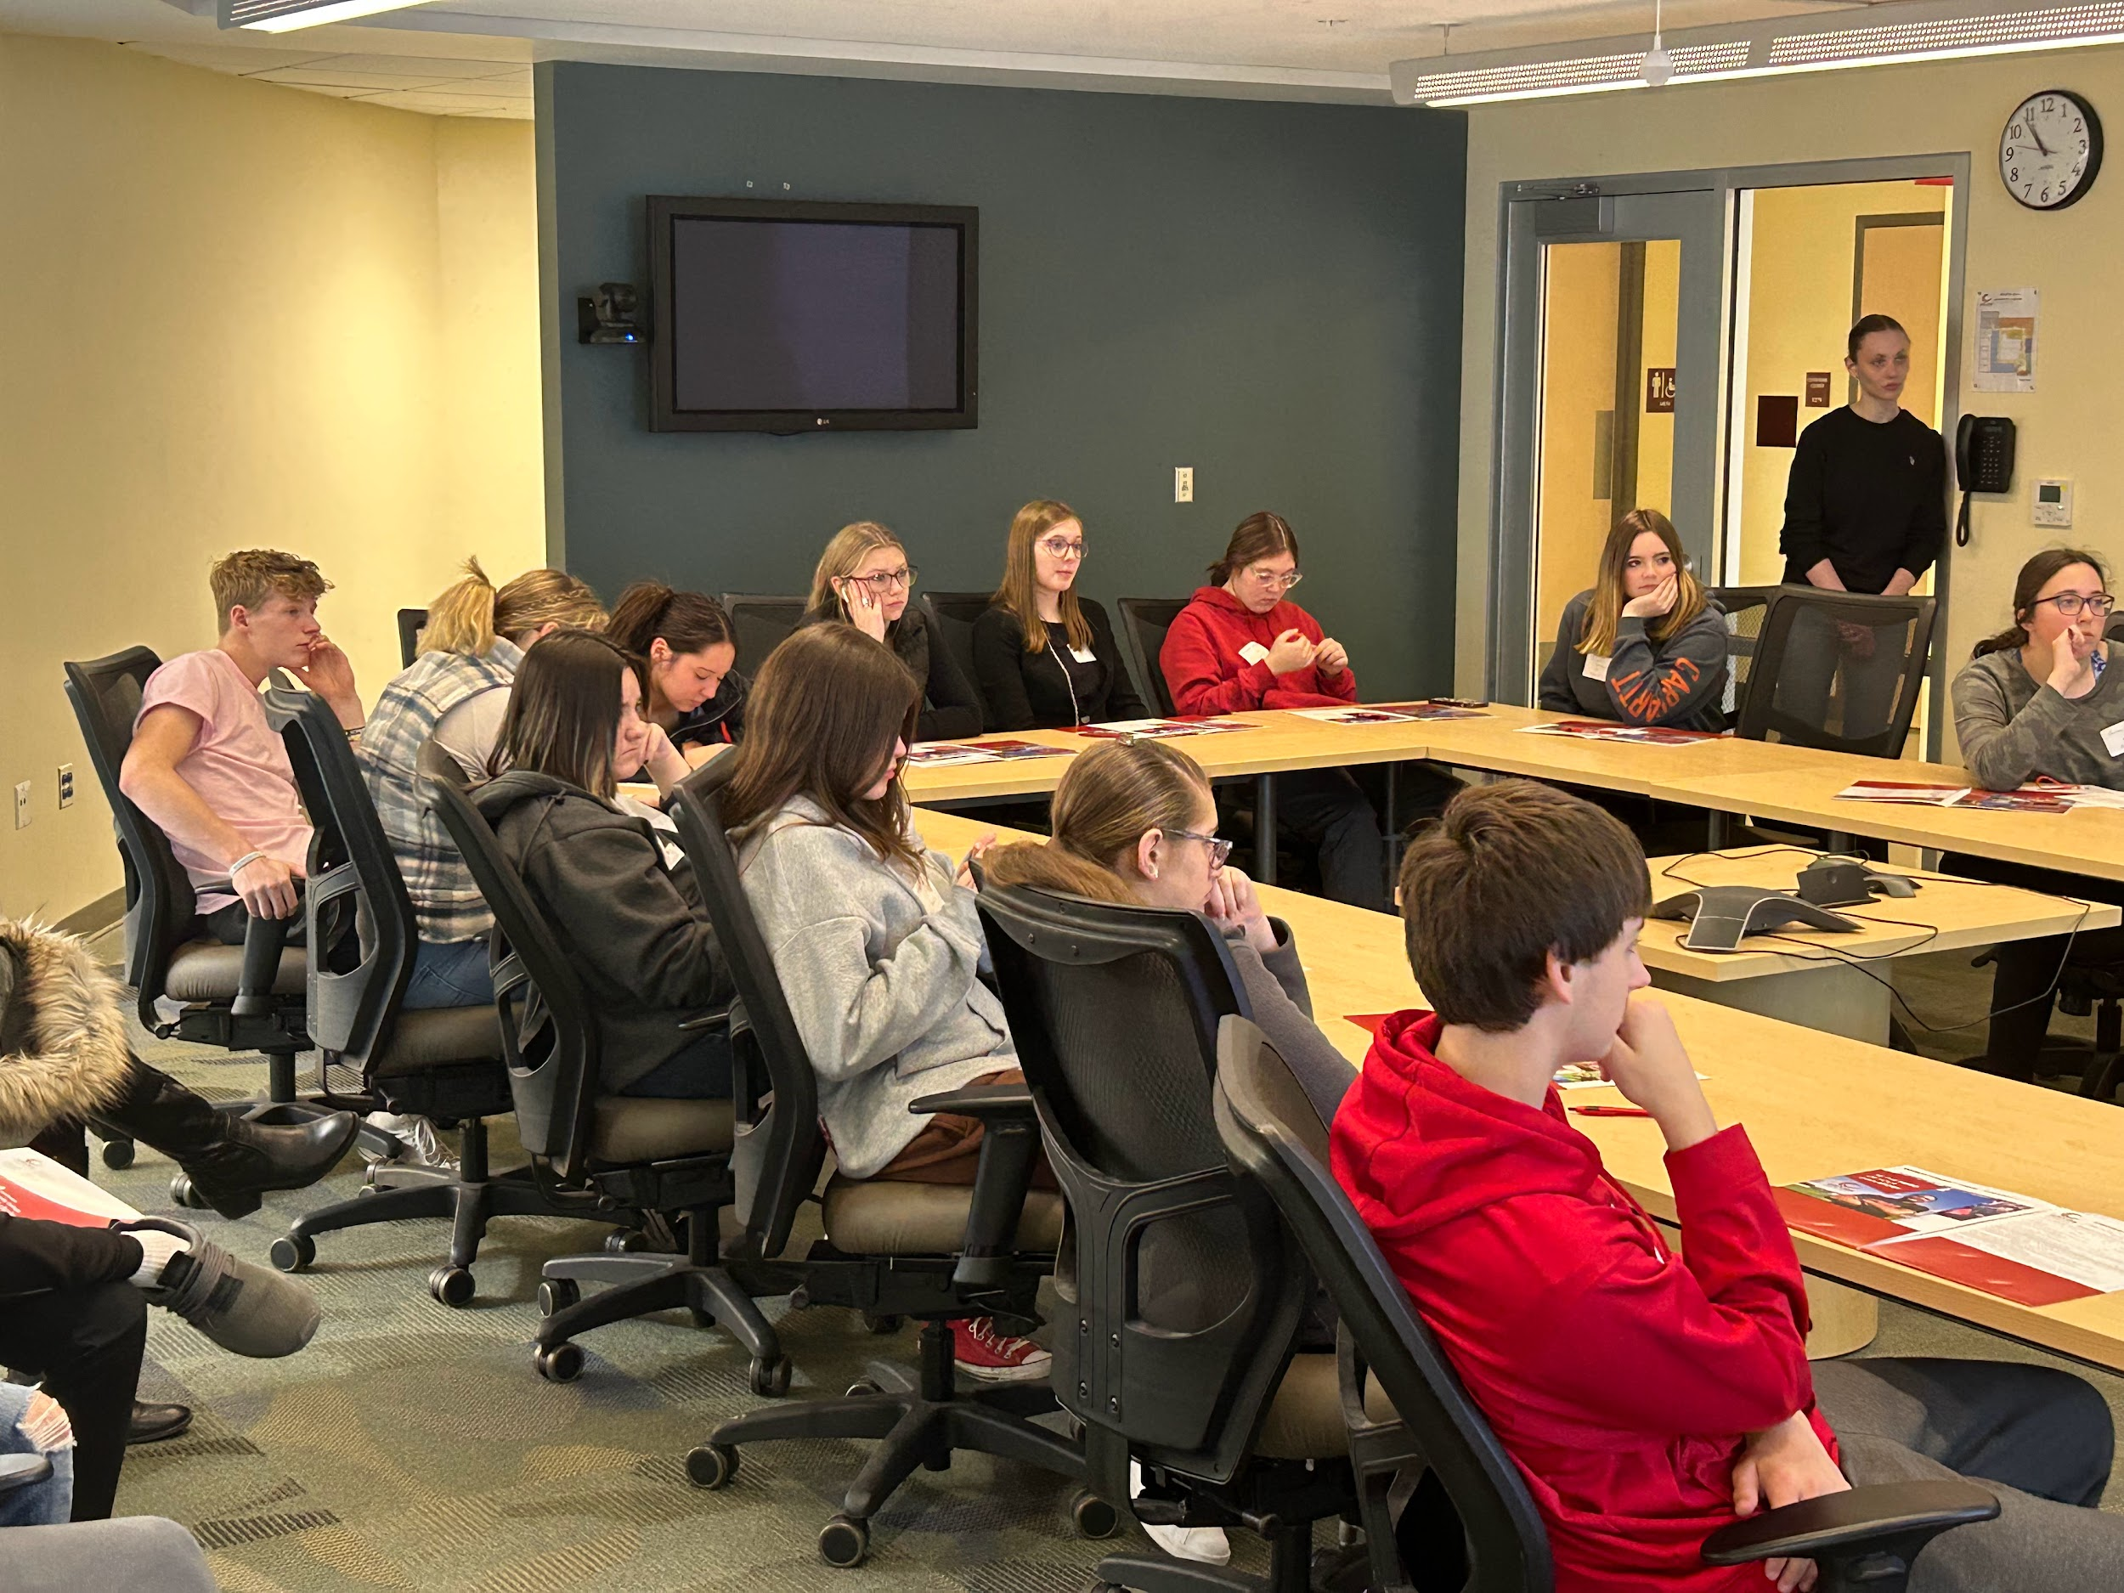
ECHS Program
Steering Committee Provides Leadership of the Program
Steering Committee Meetings Monthly (or more often when necessary)
Steering Committee Comprised of Principals of Respective High Schools, ECHS Coordinators, FCSD Deputy Superintendent, FCSD Dir. of STEAM, CCC Director of K-12 Partnerships, CCC Associate Vice President and Academic Dean of Fulton Campus, CCC Coordinator Bridge to College Programs and Division Chair of College Studies, Director of HR Oswego Health, Senior Director of OCO Program Services, Executive Dir. of Oswego County Workforce Development, MACNY Workforce Development Specialist

Slide 3
Partners
FULTON CITY SCHOOL DISTRICT
HANNIBAL CENTRAL SCHOOLS
MEXICO ACADEMY AND CENTRAL SCHOOLS
CAYUGA COMMUNITY COLLEGE
OSWEGO COUNTY WORKFORCE DEVELOPMENT BOARD
OSWEGO HEALTH
OSWEGO COUNTY OPPORTUNITIES
THE MANUFACTURERS ASSOCIATION OF CENTRAL NEW YORK

Slide 4
Pathways
Information Technology
Games Designer
Web Developer
IT Consultant
Network and Data Communications Analyst
Network Administrator
Computer Security Specialist
Security Engineer
Systems Administrator
Database Administrator
Health Sciences
Nursing
Occupational Therapy Assistant
Physical Therapy
Radiation Therapy
Respiratory Therapy
Medical Imaging
Cardiovascular Perfusion
Chiropractic Medicine
Medical Technology
Registered Nurse
$81,220/year
2022 Median Salary US Dept of Labor
Computer Programmer
$97,800/year
2022 Median Salary US Dept of Labor

Slide 5
ENROLLMENT TARGETS
First generation college attendees
Students that fall in the 65-80 percentile for overall academic achievement
Economically Disadvantaged students
Students must not have excessive disciplinary problems (0-1 major referrals)
Students must have an attendance record of 90% or higher
**If students do not meet the above listed requirements, they may also be considered based on teacher recommendation

Slide 6
Pathway Progression
YEARS 1-4
No cost to the student or their family.
Applicable classes are free while in high school.
@ GRB
@
CCC
Year 1 - Grade 9 |  |  | 9th and 10th grade at GRB
Year 2 - Grade 10
Year 3 - Grade 11
Year 4 - Grade 12 |  |  | High School Diploma & 34 [HS] or 32 [IT] or more SUNY Credits
 |  |  | Associate’s Degree 64 [HS] or 62 [IT] SUNY Credits
* Summer class between Freshman / Sophomore year: 3 weeks for HS, 1 week for IT
Notes:
add in changes for IT

Slide 7
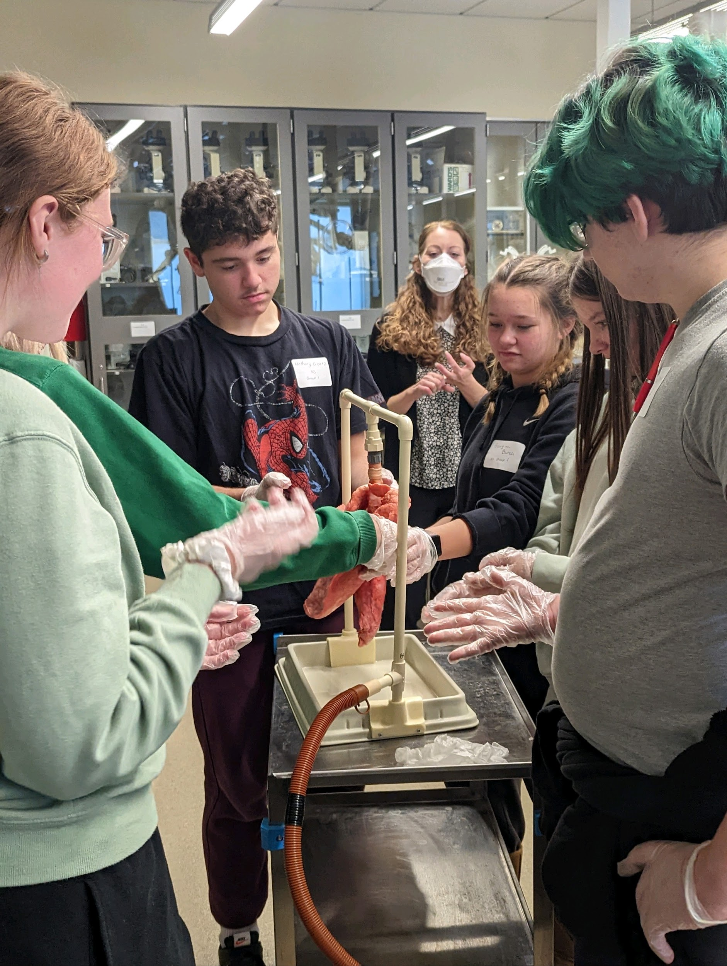
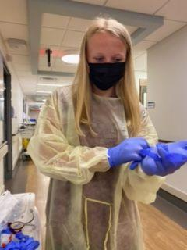
Career Development Pathway:
Health Sciences
Notes:
move to where the specifics of each program start

Slide 8
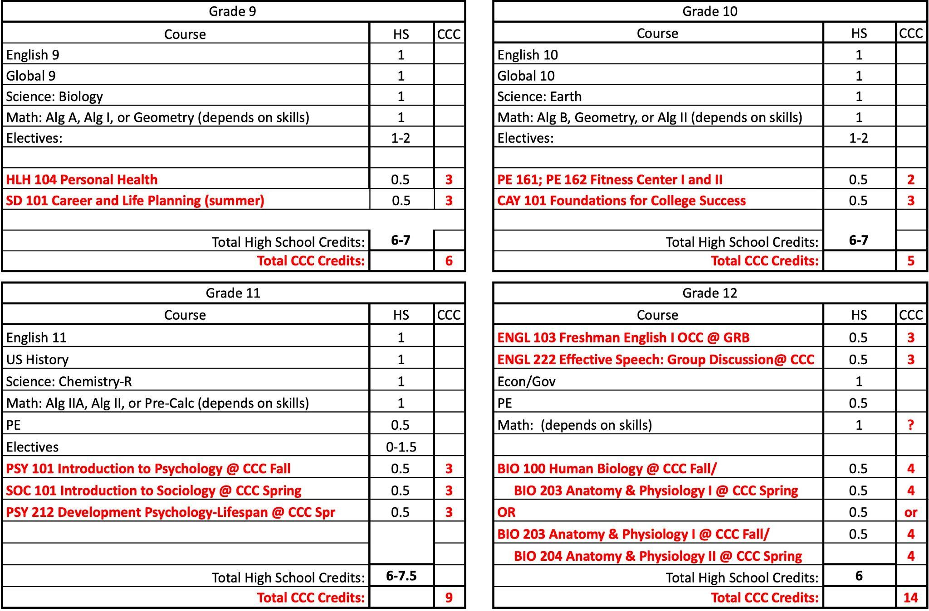
Health Sciences FOUR YEAR PLAN
*This plan is subject to change based on a variety of factors.
13%
27%
Note: CCC classes are electives and may replace Music, Art, Band, etc.

Slide 9
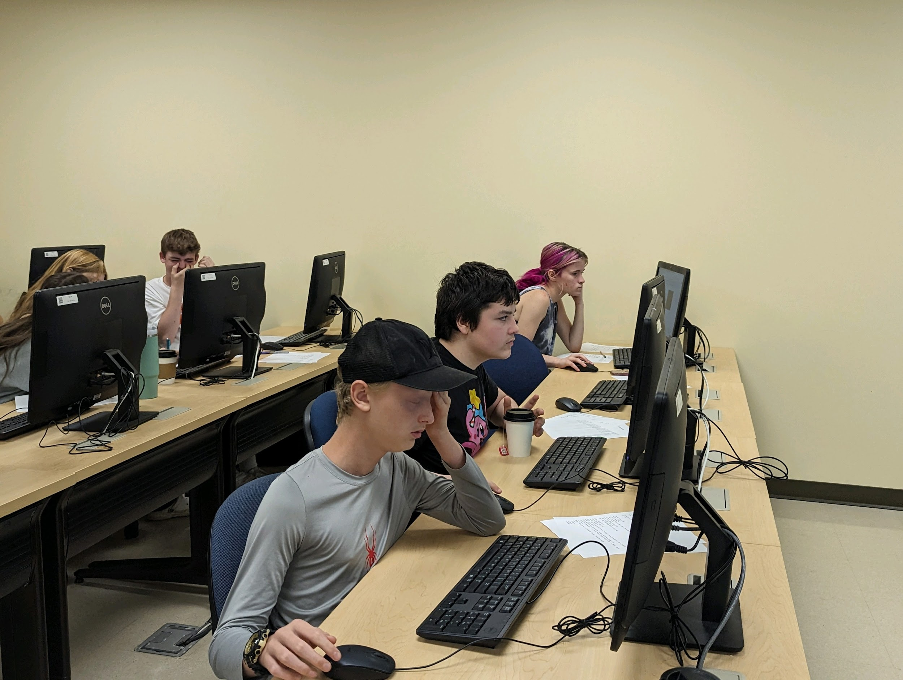
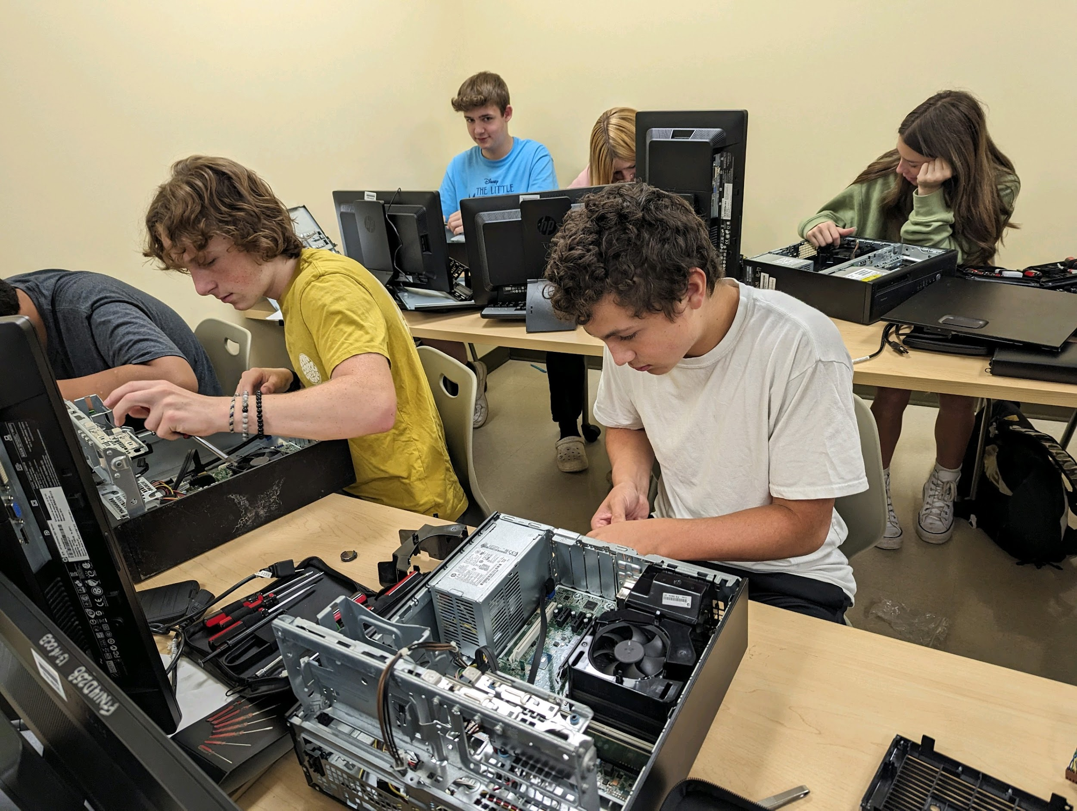
Career Development Pathway:
Information Technology
Notes:
move to where the specifics of each program start

Slide 10
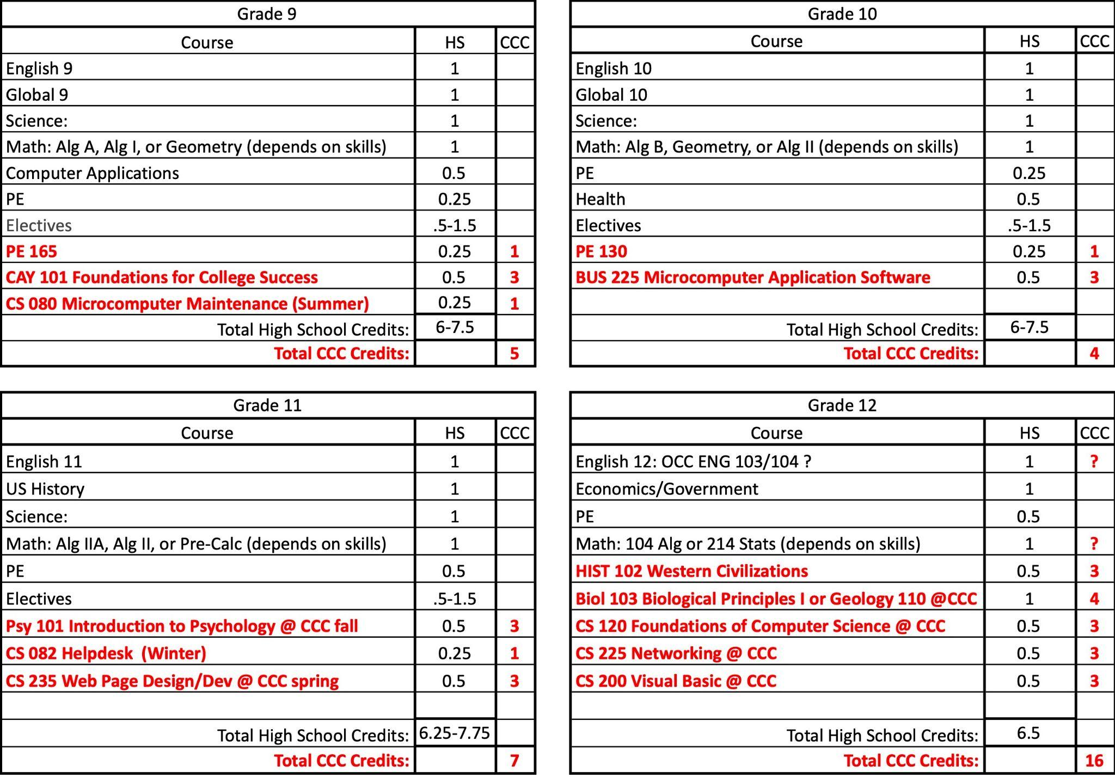
Information Technology FOUR YEAR PLAN
*This plan is subject to change based on a variety of factors.
13%
27%
Note: CCC classes are electives and may replace Music, Art, Band, etc.

Slide 11
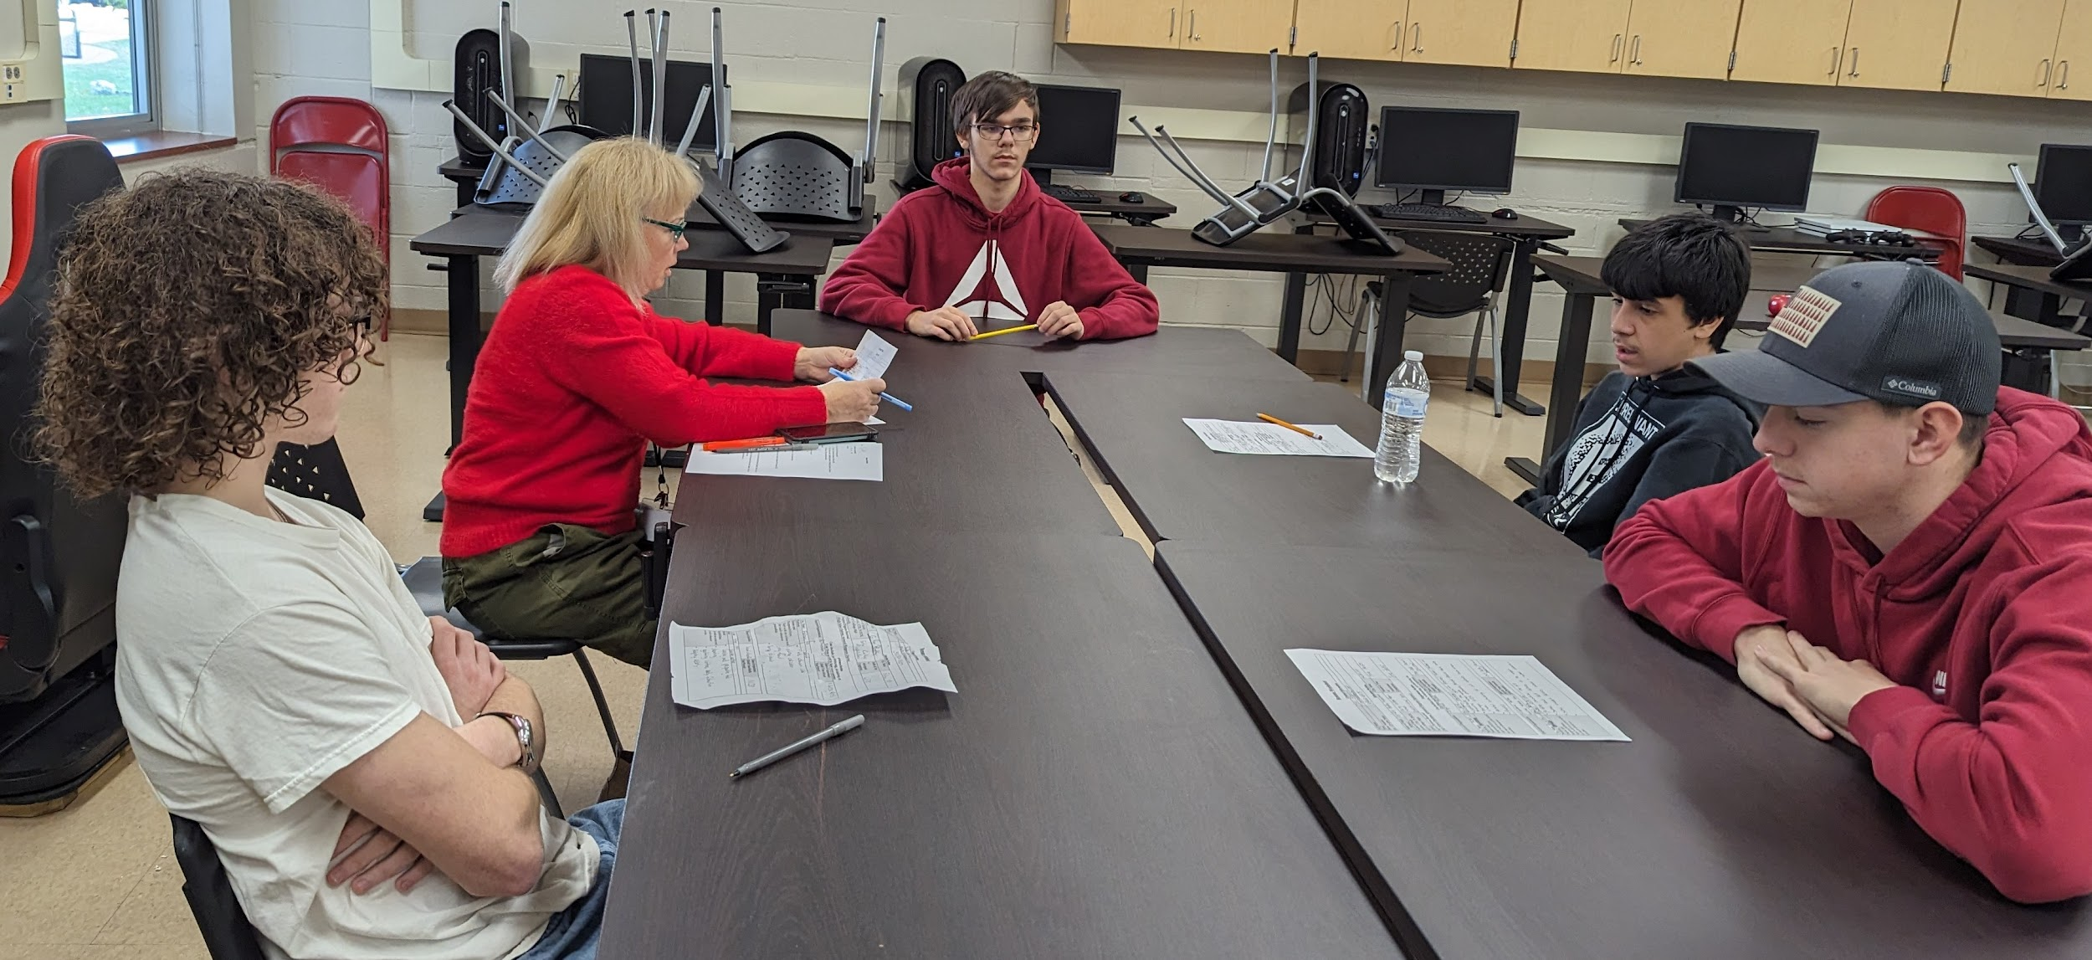
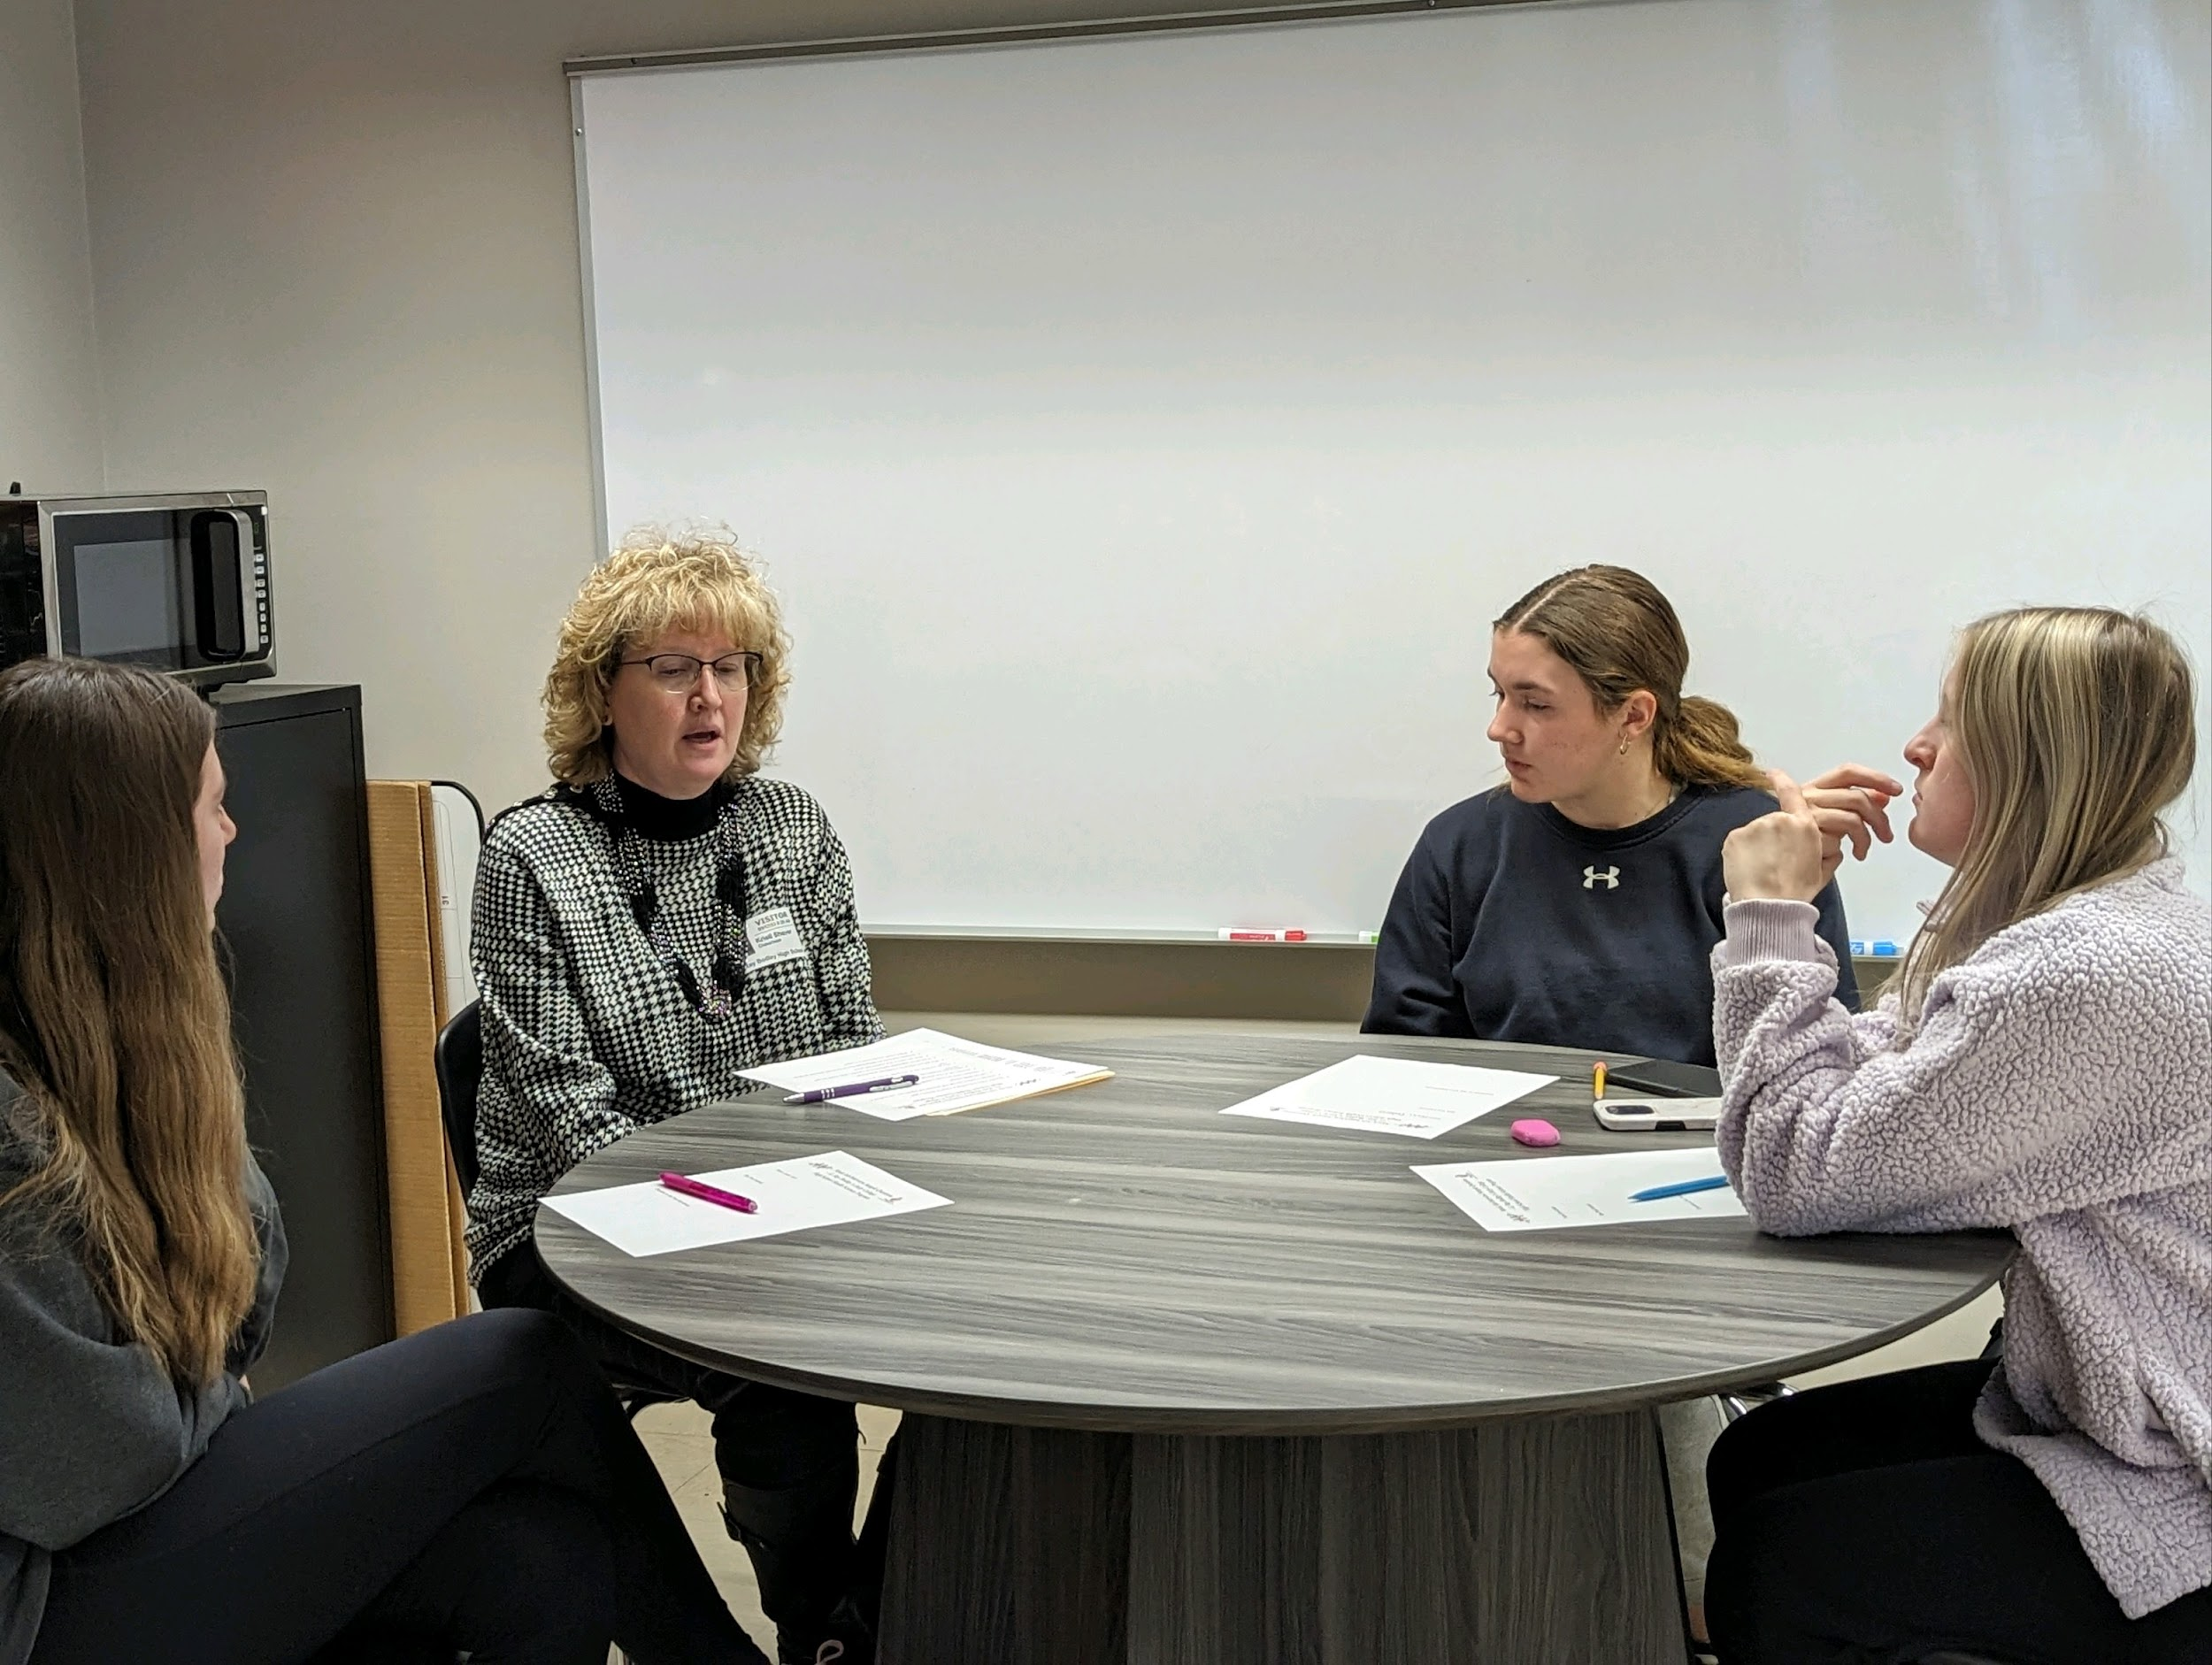
ECHS Expectations
#1 Attend MACNY events grades 9 - 12 and CCC Support classes grades 11 and 12
What are Support classes?
Opportunities to learn how to navigate the college environment and
meet with professionals in the field!
Create a plan for college success
learn good study skills
build soft skills
and much more
resume preparation
mock interviews
and career readiness discussions with employers

Slide 12
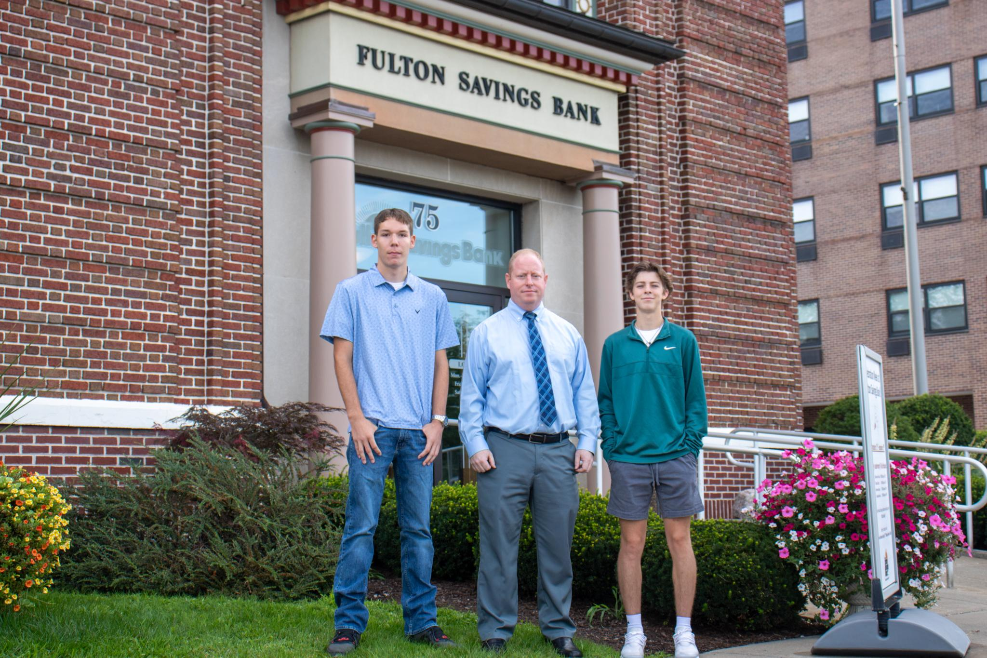
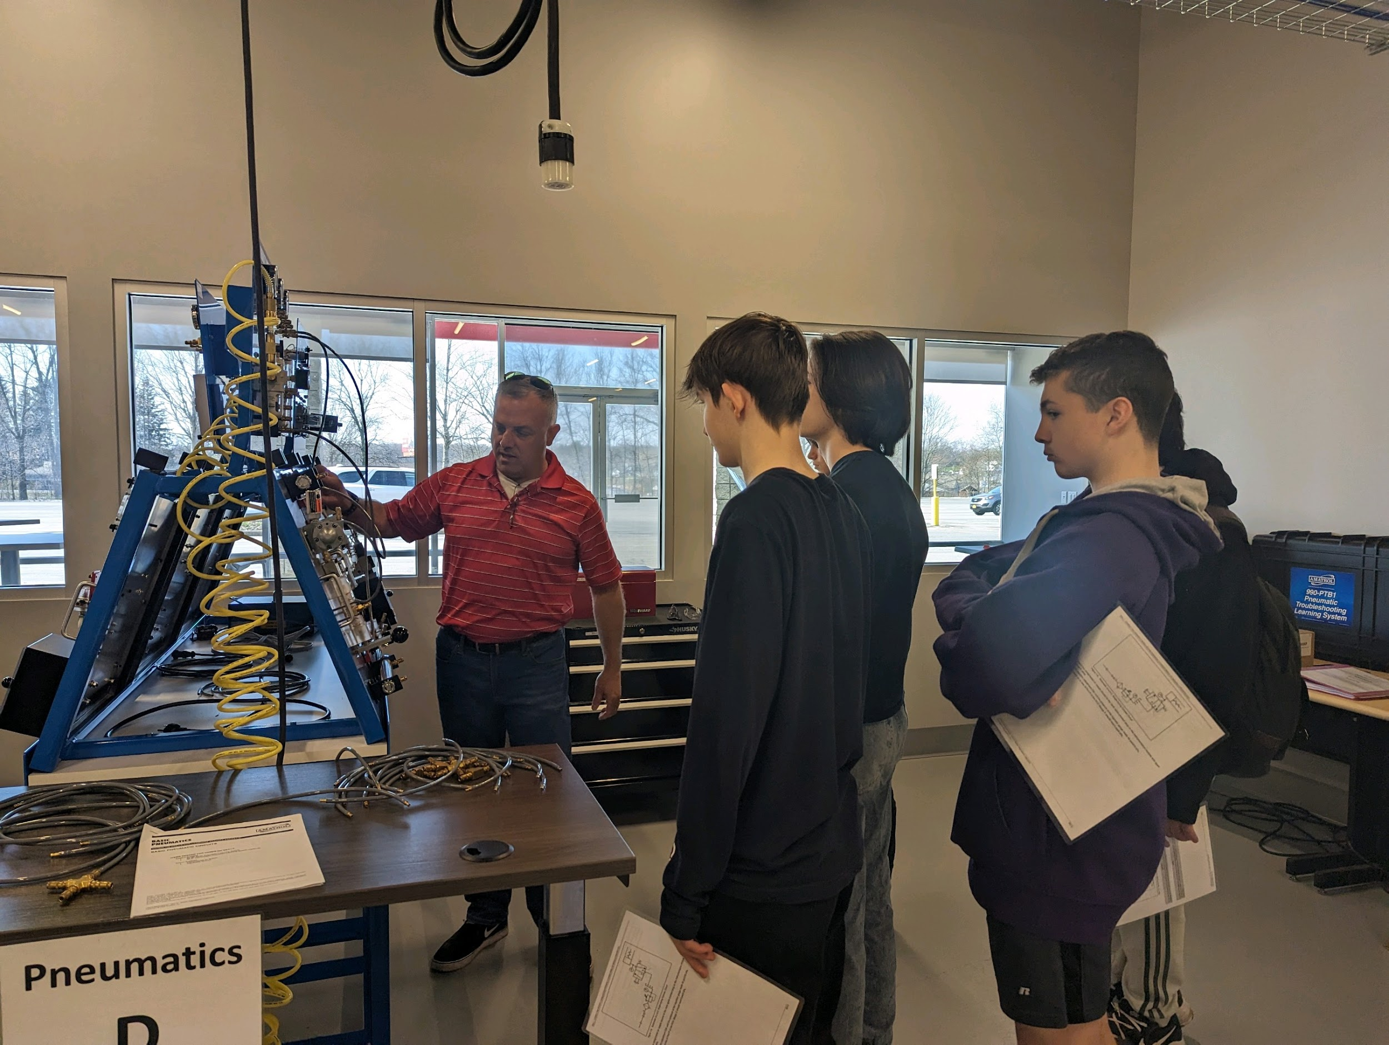
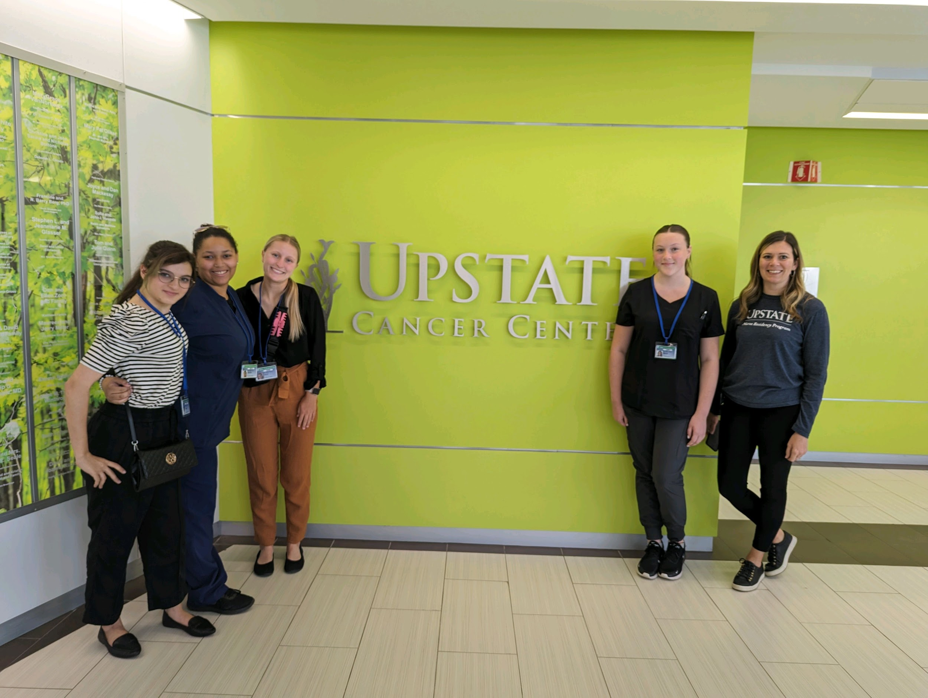
ECHS Expectations
#2. Attend site visits, job shadowing and internship opportunities
Site visits - IT
SUNY Oswego IT
Elite Gaming
JMA Wireless
WCNY
Syracuse Airport
Usherwood
Job Shadowing:
Oswego Health
Upstate University
Fulton Savings Bank
Site Visits - Health Science
SUNY Oswego Athletics
St. Joseph’s College of Nursing
American Red Cross
Oswego County 911
Menter Ambulance
Arise Adaptive Design

Slide 13
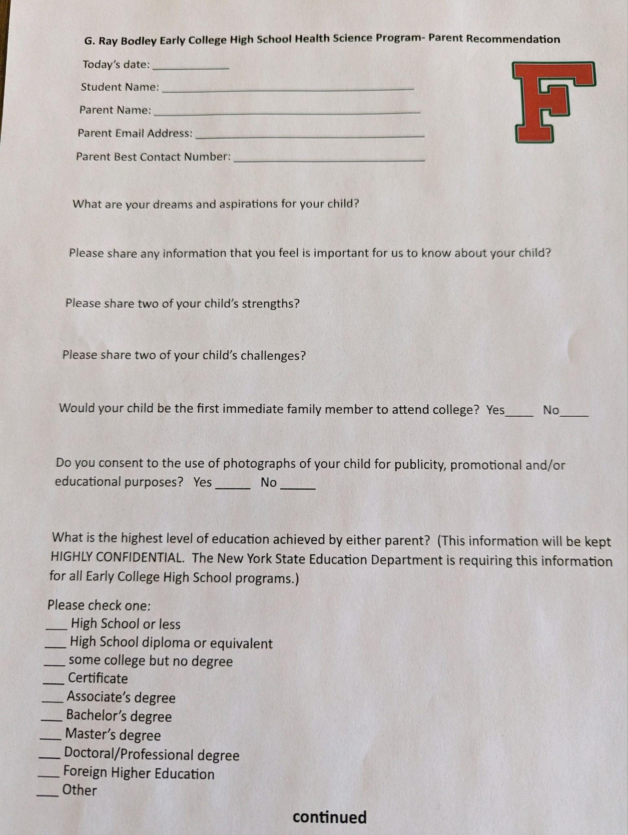
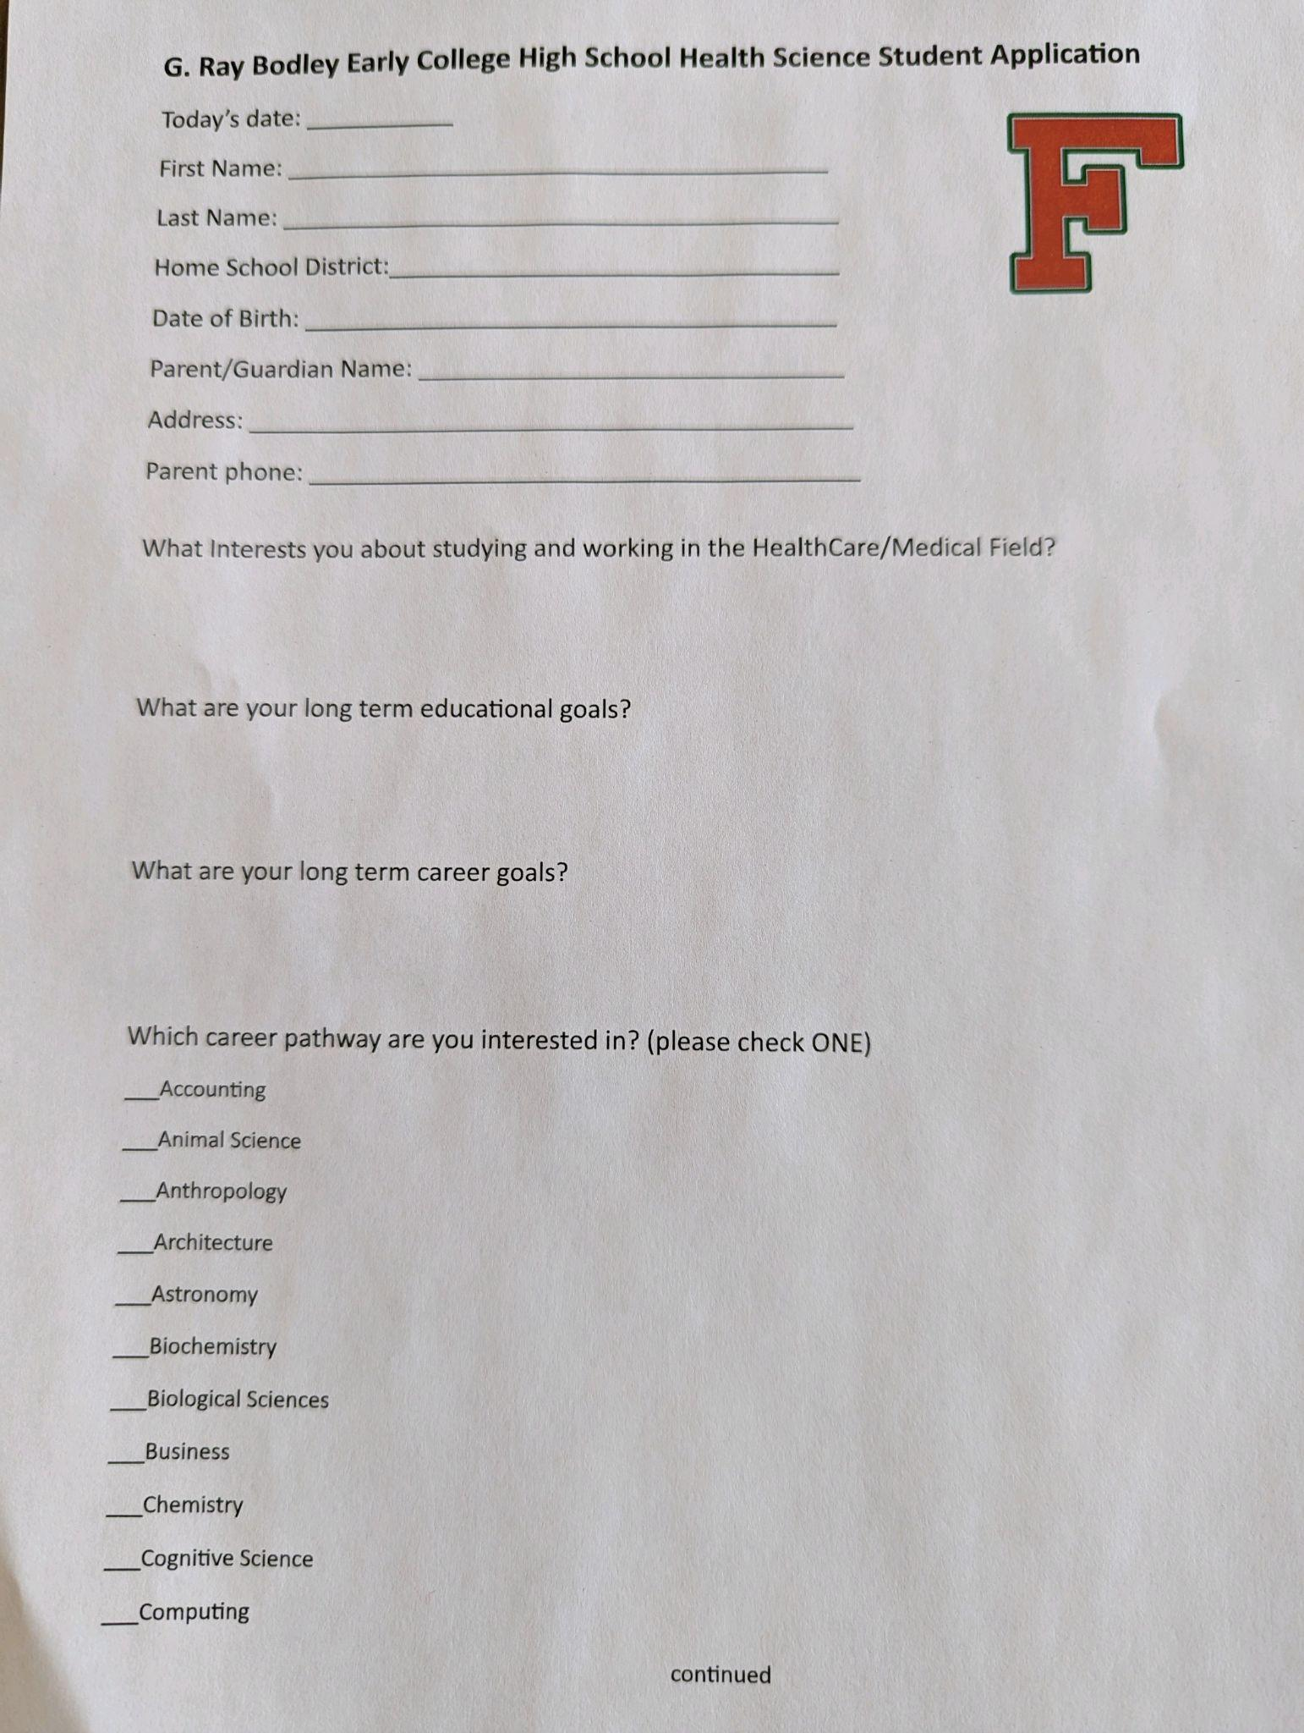
The Application Process
The process is simple
Students complete an Application
Parents complete the Parent Recommendation form
Students are scheduled for a 15-30 minute interview with ECHS Staff
Parents and students will be informed of their acceptance in June
Applications and Parent Recommendation forms can be found in the FJH Counseling Office or completed online at the following link:
ECHS Link

Slide 14
Contact Information
Sean Broderick, ECHS Program Director
sbroderick@fulton.cnyric.org
office: 315-593-5400 (ext. 2489)
cell: 315-593-5218

